Slide 1
ETL service
Resources and microservices
Anoshenko Daniil will get access to the K8s cluster

Slide 2
Product description
ETL service for private data cleansing Data quality and availability is important for applications running in the framework. The framework defines so-called data modules stored on S3 or in a RDBMS. A data module is described by a json-ld compatible metadata, a collection protocol and the versioned data. The ETL service would extract data from internal corporate systems, cleanse, merge, anonymize, transform the data and upload it to a new version of a data module. Then the module can be used by machine learning applications deployed on the framework.
Team: Anoshenko Daniil, Rogoza Kirill, Sergey Rogachev, Pham Manh, Denune Pravira
Repo: https://github.com/Neovodoo/ETL

Slide 3
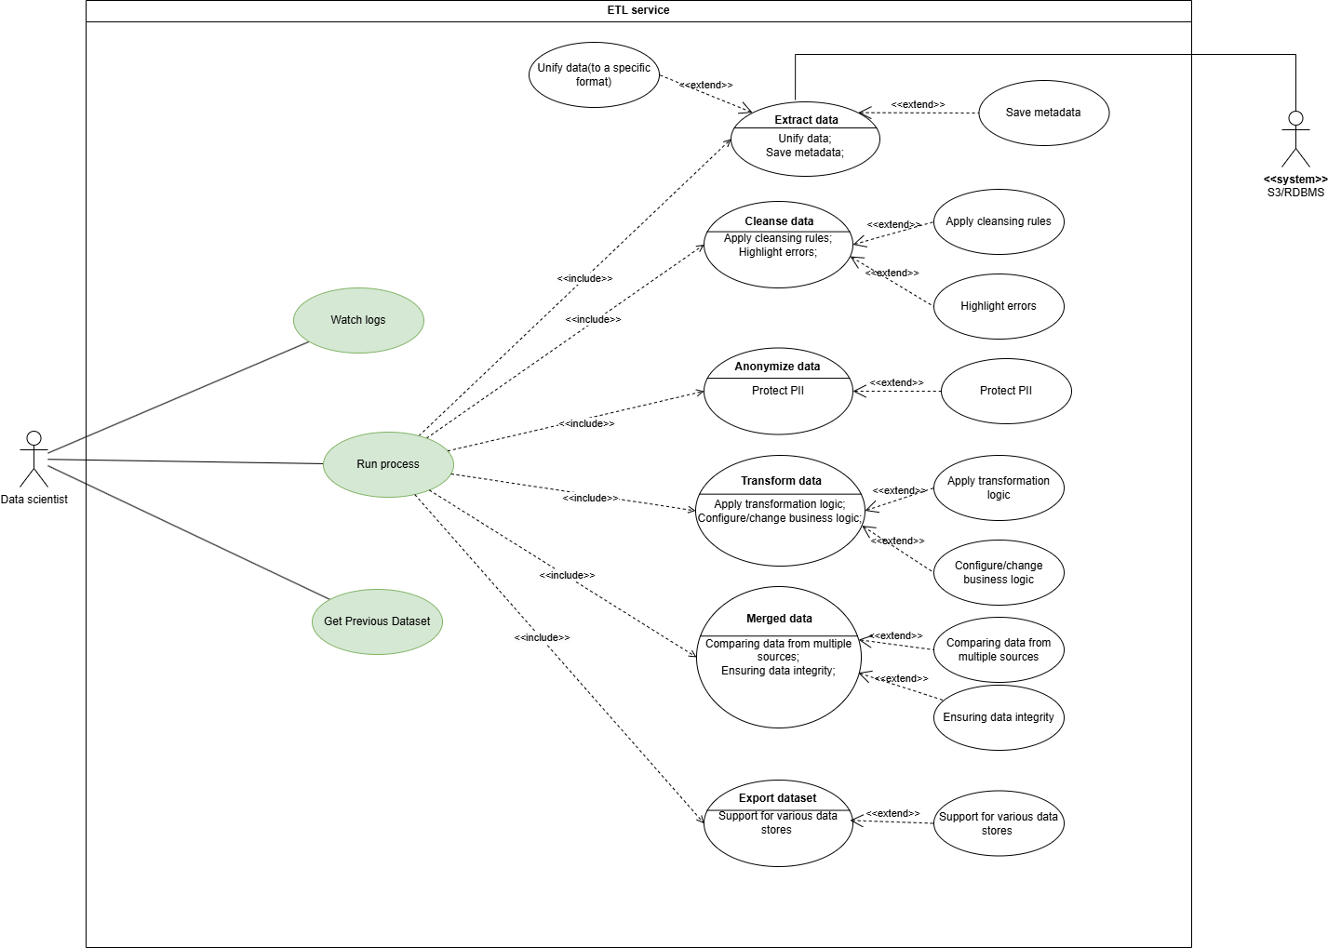
Use case diagram

Slide 4
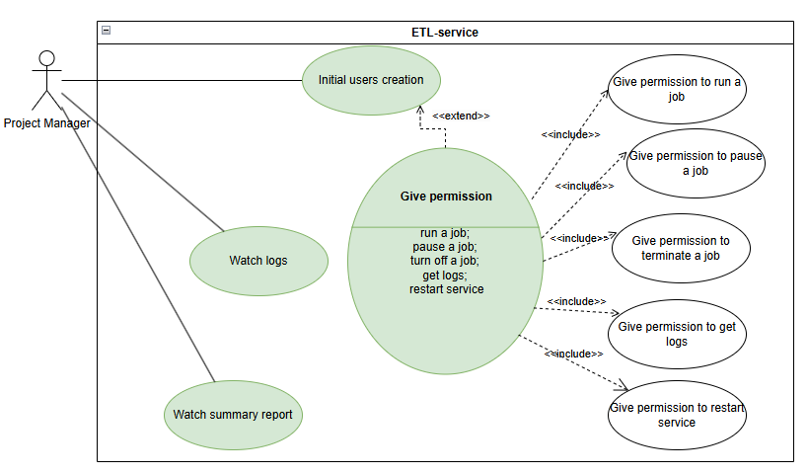
Use case diagram

Slide 5
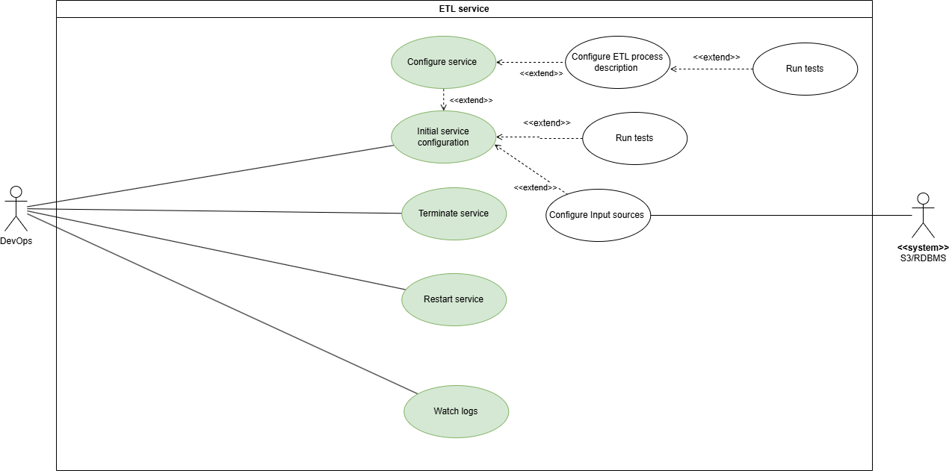
Use case diagram

Slide 6
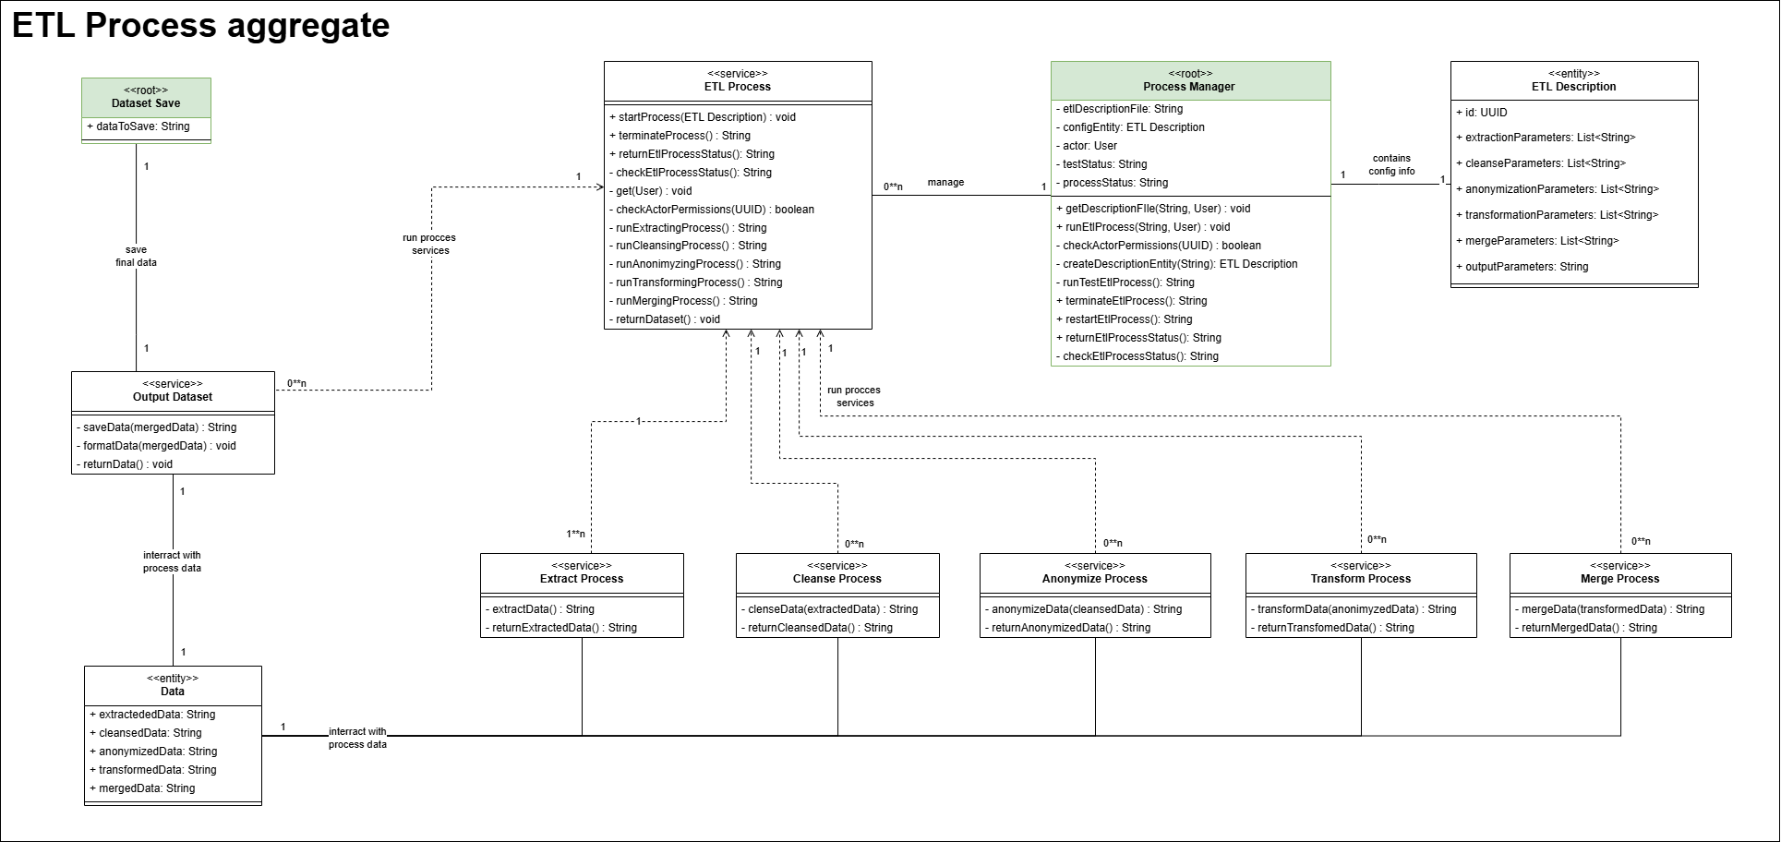

Slide 7
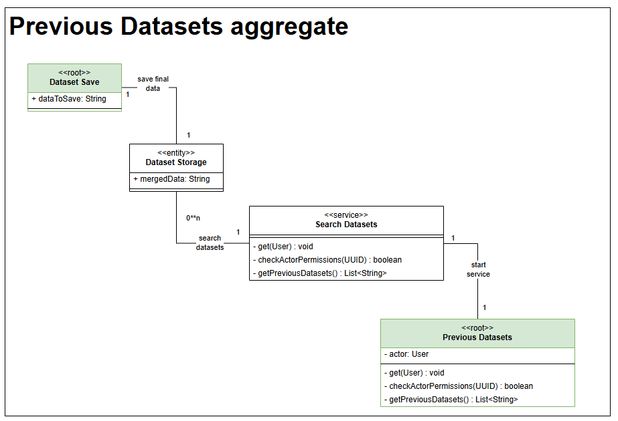

Slide 8
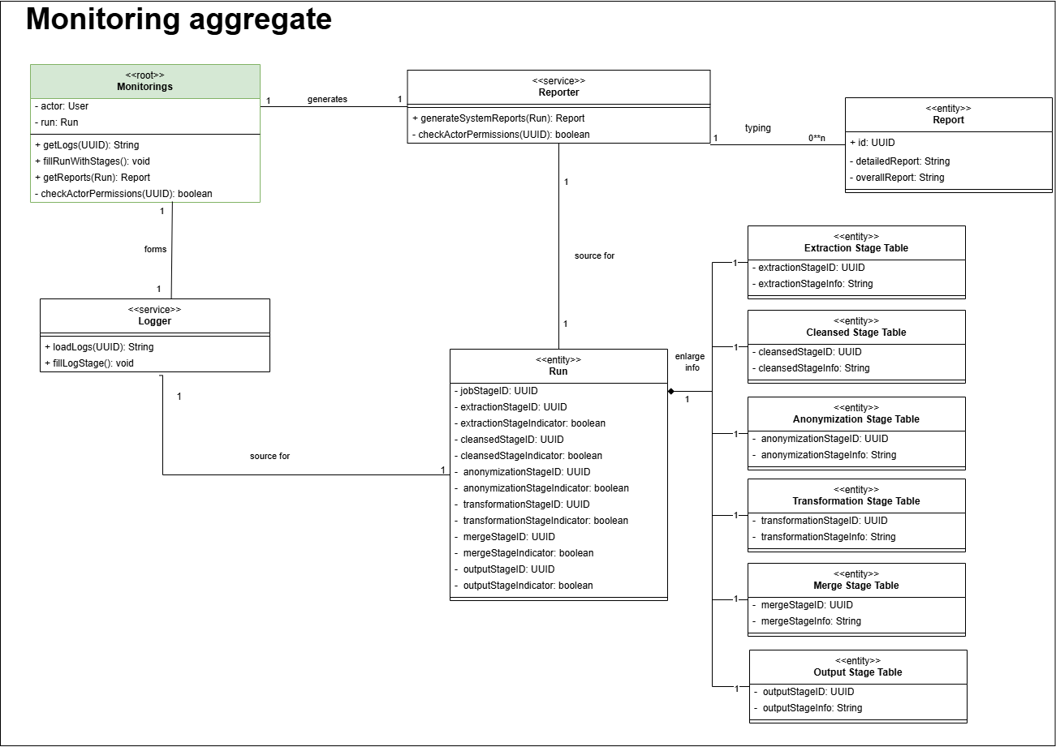

Slide 9
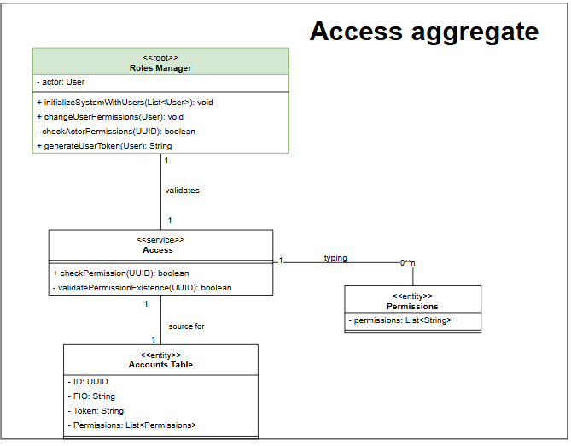

Slide 10
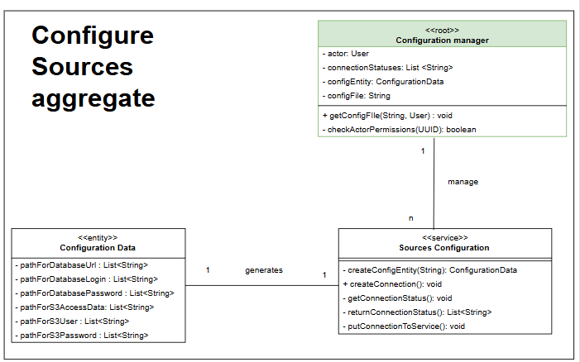

Slide 11
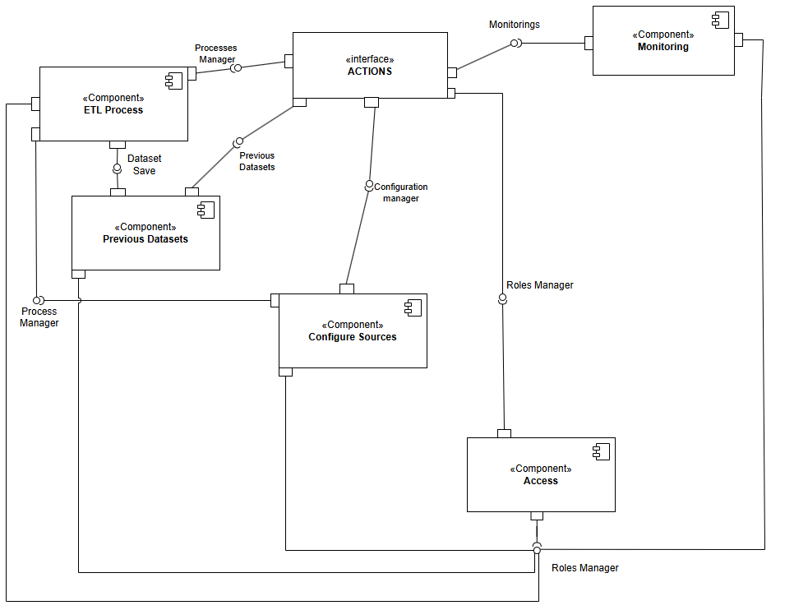
Service diagram

Slide 12
Traceability
Microservice (component) | Resource (interface) | Domain classes in the microservice | Use case that use the microservice
ETL Process | Process Execution; Process Manager; Dataset Save; Roles Manager; | Dataset Save; Data; Process Manager; ETL Description; Process Manager; ETL Process; Extract process; Cleanse process; Anonymize process; Transform process; Merge process; Output Dataset; Dataset Storage | Run process; Configure process; Terminate service; Restart service
Previous Datasets | Dataset Save; Roles Manager; Previous Datasets | Dataset Save; Dataset Storage; Dataset; Search Datasets; Previous Datasets | Get previous datasets
Configure Sources | Configuration Manager; Roles Manager; | Sources configuration; Configuration Data; Configuration Manager | Configure service; Initial service configuration
Access | Roles Manager | Roles Manager; Access, Permissions, Accounts Table | Initial user creation; Give permission
Monitoring | Monitorings; Roles Manager | Monitorings, Reporter; Report, Logger, Run, Extraction Stage Table, Cleansed Stage Table, Anonymization Stage Table, Transformation Stage Table, Merge Stage Table, Output Stage Table | Watch logs; Watch summary report

